Slide 1
WELCOME

Slide 2

DOMAIN SPECIFIC MINI PROJECT PRESENTATION ON -
WOMEN SAFETY APP ANDROID APPLICATION

Slide 3

Dr. Daulatrao Aher College Of Engineering, Karad
Presented By
Guided By
Shraddha Shekhar Kashid 23066
Vaishnavi Pravin Patil 23068
Vaishnavi Shashikant Shinde 23071
Vaishnavi Vishnu Patil 23073
Mrs. T. R. Shinde

Slide 4
CONTENT
Introduction
Problem statement
Scope and Objective
Software and Hardware Requirement
Block diagram
Implementation / Snapshots
Future Scope
Conclusion

Slide 5
INTRODUCTION
In Safety domain especially in India, most of the women’s are worried about their safety during any situations. This is achieved by addressing the circumstances that compromise the safety of women in today's day and age. Sadly, sometimes women face dangerous situations, and this app aims to give them tools to protect themselves. The features like showing where you are, sending out alerts with your current location if you're in trouble. The user selects the contacts to which the alert message and location has to be sent and save it. So, when she is in some danger by just opening the app and pressing the some key button and shaking the phone, the message containing her current location will be sent to the number she has added in this application.

Slide 6
PROBLEM STATEMENT
Women’s safety in India is a widely discussed and serious problem. Now a days Sadly, Many women encounter dangerous situations like harassment, assault, and discrimination. As travel safety has been a major concern with respect to women. Some women don't know how to protect themselves or what to do in emergencies.

Slide 7
SCOPE AND OBJECTIVE
Scope
The scope of a women's safety app can encompass a wide range of features and functionalities like Location and SOS alerts aimed at addressing the safety concerns.
The app should provide quick and easy access to emergency contacts and also provide information about basic women’s related laws.

Slide 8
Objective
Enable users to share their real-time location with trusted contacts raise awareness about women's safety issues, educate users about preventive measures.
Create User Interface design for easy accessibility for women users.

Slide 9
SOFTWARE AND HARDWARE REQUIREMENT
Software
Android Studio lguana 2023.2.1 version
Sqlite
Hardware
HP Laptop i5 x64 based processor 8 GB RAM
Android Mobile Device

Slide 10
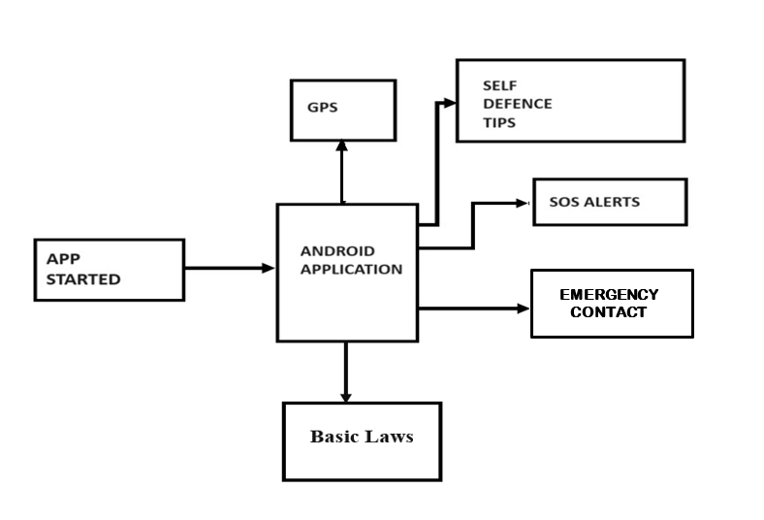
BLOCK DIAGRAM

Slide 11
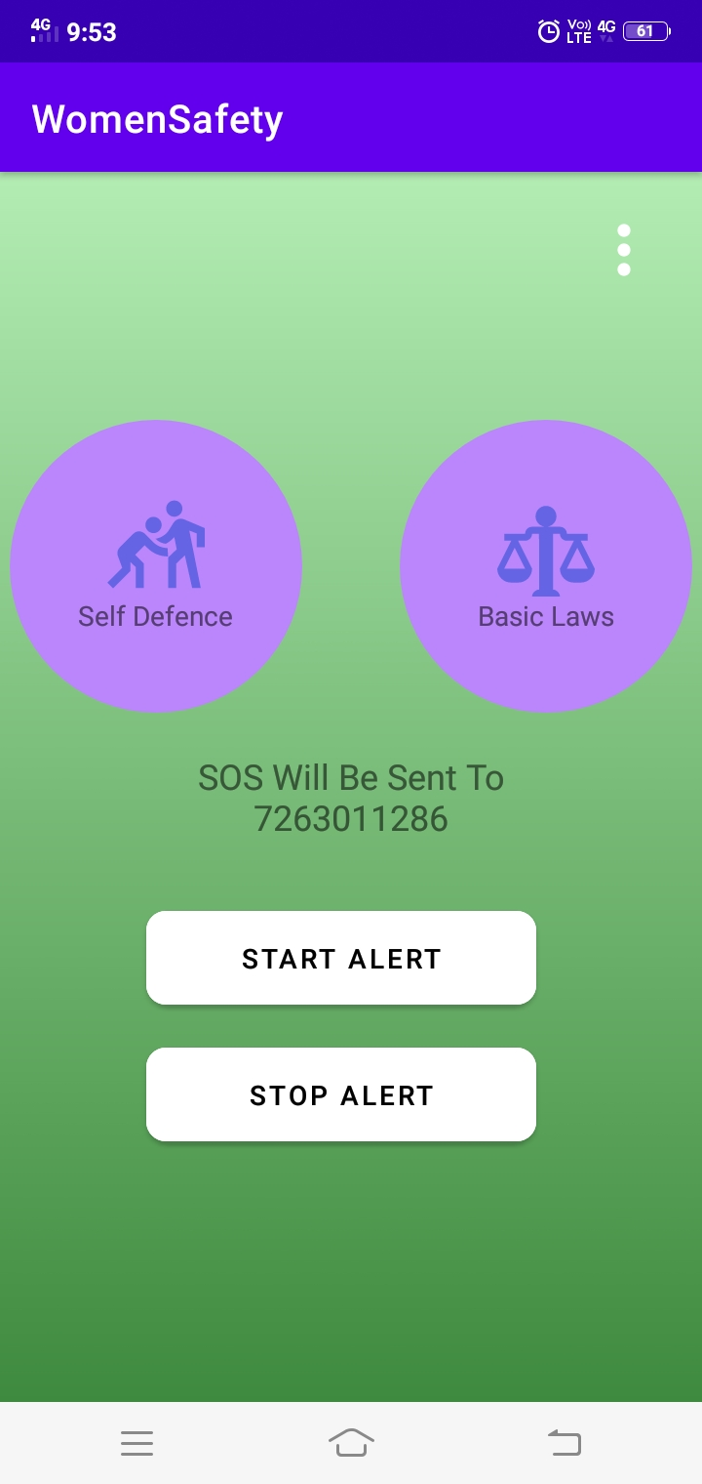
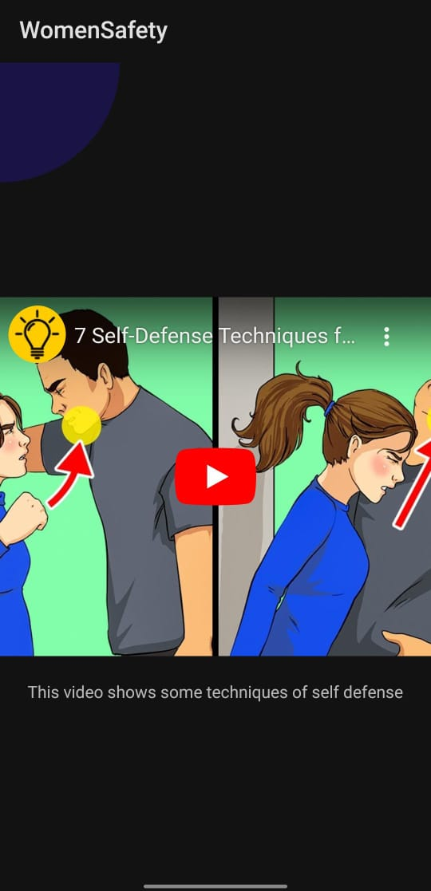
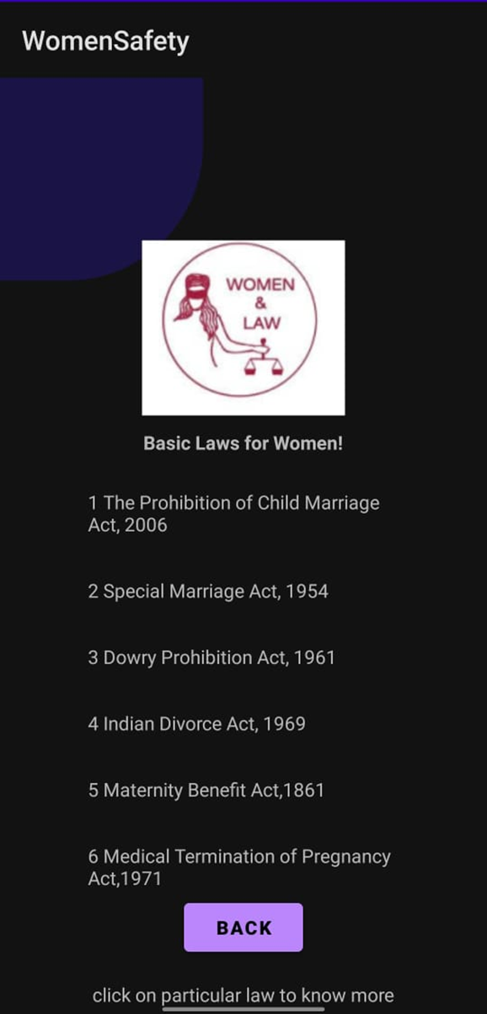
IMPLEMENTATION / SNAPSHOTS

Slide 12
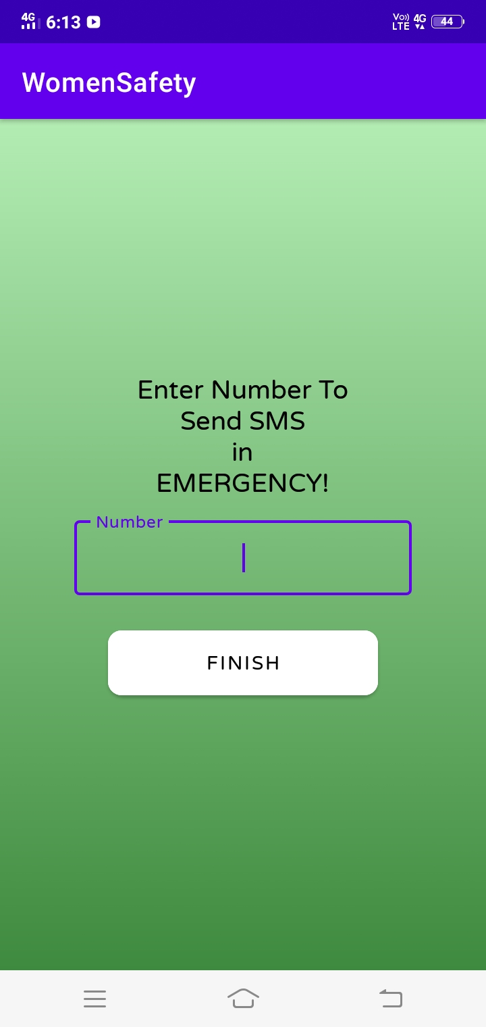
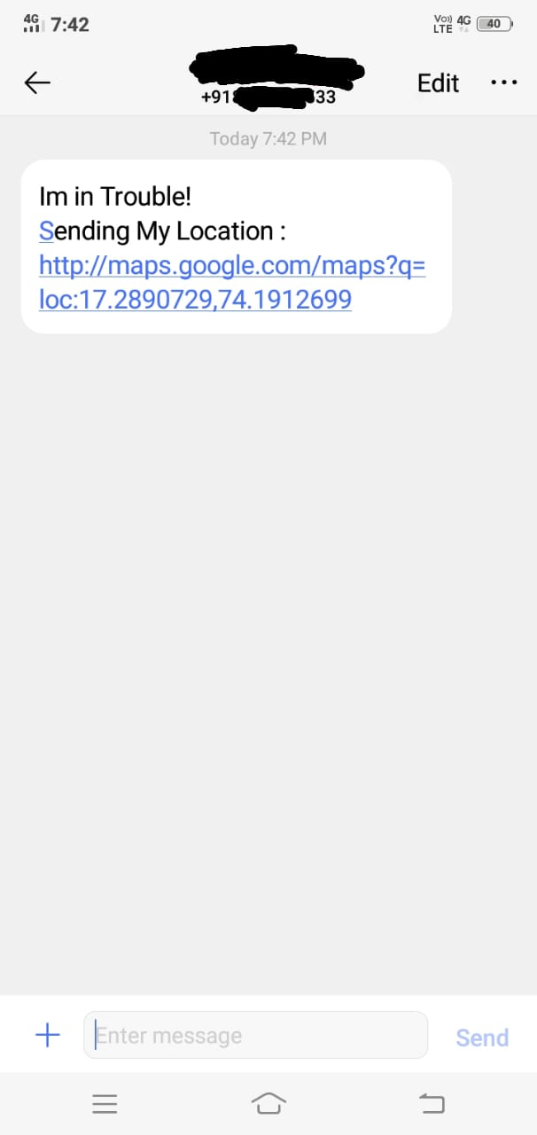
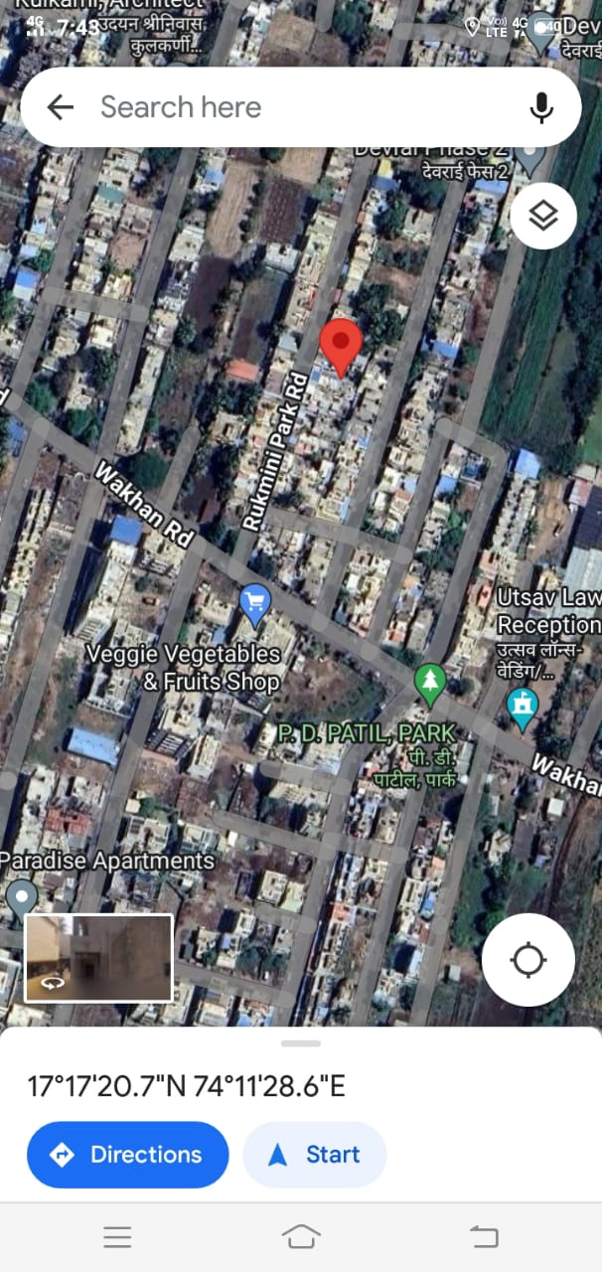

Slide 13
FUTURE SCOPE
Real time Tracking : Implementation of real time tracking of users location.
Voice Activation : Implementation of voice activation for sending alerts.
Offline Mode : Develop an offline mode that enables app to function even when there is no internet connection.

Slide 14
CONCLUSION
In conclusion, the “Women Safety App Android Application” is the best app to inform and update your close ones if you are in an unsafe place. The app is the fastest and easiest way to update your close ones about your location. You will never feel unsafe with this app. Keep it installed and stay alert.

Slide 15
THANK YOU

